Slide 1
Ark Encounter
Statements On
Genetic Differences
By Ed Hensley
Bible Background – Noah’s sons Ham, Shem and Japheth and their wives repopulate earth.
Genesis 9 – Curse of Canaan. Ham sees Noah drunk & naked & tells brothers. Ham’s son Canaan and his descendants are cursed to be slaves of Japheth and Shem’s descendants.
Genesis 10 – Table of Nations. Descendants of Japheth, Shem and Ham divide into different tribes, nations, and/or races. This implies brother-sister incest of children of each son.
Genesis 11 – Tower of Babel. People are dispersed throughout the world and speak different languages.

Slide 2
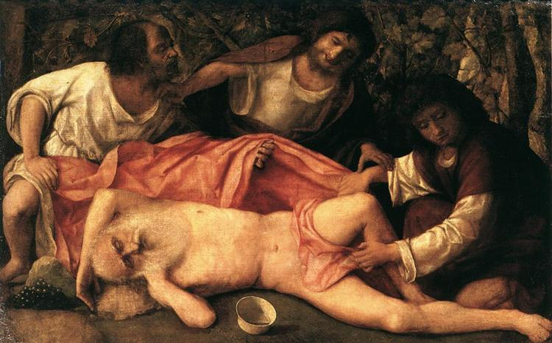
Noah’s Curse on Canaan, Genesis 9
Used by ancient Jews/Israelites to justify their myth regarding the slaughter of the Canaanites and claims to the land from Canaanites.
Archaeology reveals that ancient Jews did not battle or steal land from Canaanites, but rather descended from Canaanites.
Abused by slave traders and owners to justify slave ownership and demonization of people with dark skin.
Sometimes called Curse of Ham.
Drunkenness Of Noah, Bellini, 1515

Slide 3
Table of Nations, Genesis10
Japheth or Iapheth is a GREEK name, not a Hebrew name. Descendants are Europeans.
The sons of Ham: Cush [ETHIOPIANS] , Egypt, Put [LIBYANS] and Canaan [ancestor of cursed CANAANITES]. Mostly people of Africa.
Sons of Shem are known as Semites and include the ancestors of Abraham, David, and Jesus (if they existed). People of the Middle East.
All scholars agree these names are eponyms.
Secular scholars believe these people are fictional names created long after nations or tribes were founded.
Fundamentalists believe these were real people who founded the tribes or nations.

Slide 4
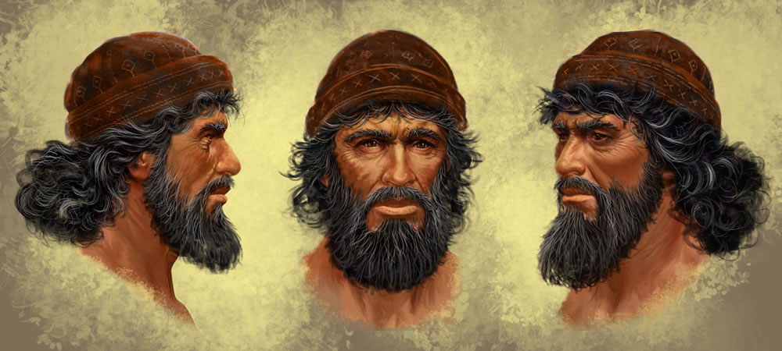
Ark Encounter Blog Posts - Noah
https://arkencounter.com/blog/2014/05/26/concept-illustrations-for-noah/
Illustration below and other head shots and text are from Ark Encounter blog posts. All photographs inside Ark Encounter are used with permission from Andy Dyson.

Slide 5
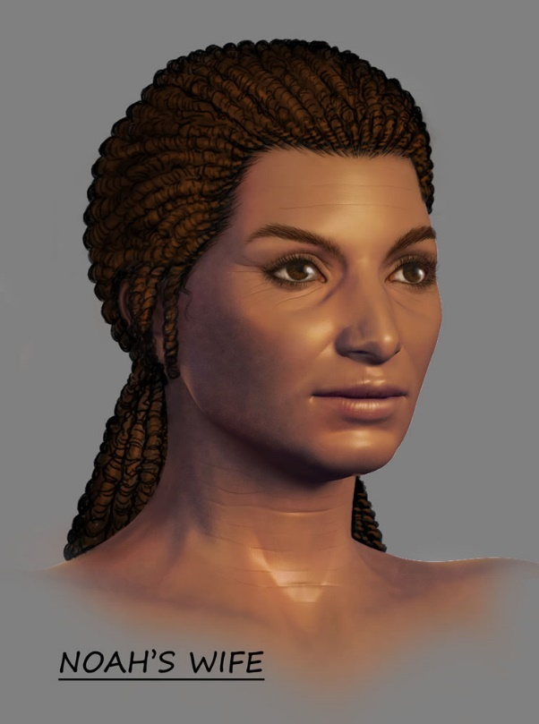
Ark Encounter – Noah’s Wife
https://arkencounter.com/blog/2014/08/14/depicting-the-arks-passengers-noahs-wife/
Noah’s wife is the great, great, great . . . grandmother to all of us, so her appearance could display a wide range of the attributes we see today. ..she would be about 500 years older than her sons and presumably that much older than her daughters-in-law.
We have Noah looking like a modern man in his 50s or early 60s, so Noah's wife can look like a woman of the same age, with middle-brown skin, dark hair, and brown eyes. It’s likely that each of the women was in fairly good shape. Since they lived closer to the time of Adam and Eve and would have had fewer genetic problems, the women should be depicted as being rather fit.

Slide 6
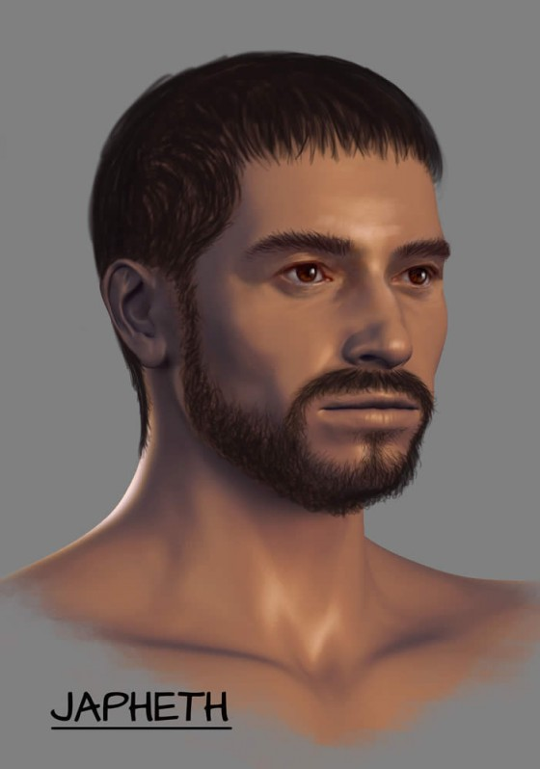
Ark Encounter – Japheth
https://arkencounter.com/blog/2014/08/18/depicting-the-arks-passengers-japheth/
At 100 years old, Japheth should look like he is in his prime. Many of Japheth’s descendants settled in Europe, so we can give him a slightly lighter skin shade than his brothers.
He may also have been a little taller than his brothers, since some northern European groups are taller than average. We could make him slightly taller than Noah…

Slide 7
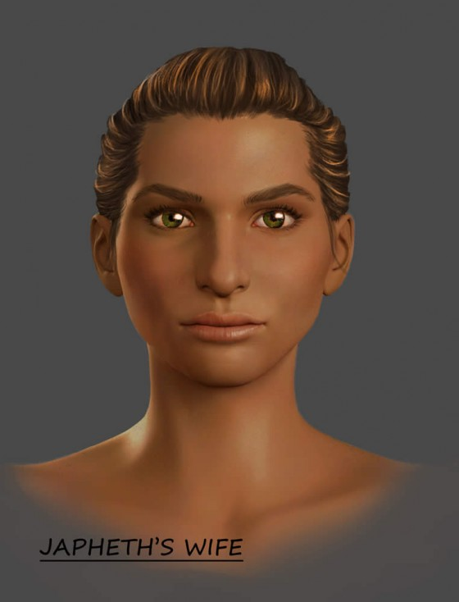
Ark Encounter – Japheth’s Wife
https://arkencounter.com/blog/2014/08/20/depicting-the-arks-passengers-japheths-wife/
Shem, Ham, and Japheth were no more than 100 years old by the time of the Flood. Their wives were likely about the same age as they were, so Noah’s daughters-in-law, like his sons, should look like they are in their 20s.
Since many of Japheth’s descendants settled in Europe, we need someone to display some of the typical European traits. Japheth’s wife can have lighter hair than the others on board. Everyone else will have brown eyes, but we can give her green eyes to show the origin of green eyes and blue eyes in our world today.

Slide 8
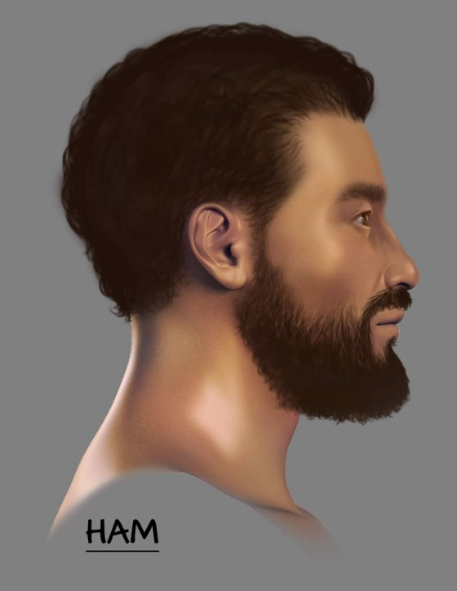
Ark Encounter – Ham
https://arkencounter.com/blog/2014/08/25/depicting-the-arks-passengers-ham/
Ham is the youngest of the boys, but we will not make him the darkest. The unbiblical and so-called “curse of Ham” … had nothing to do with skin tone.
Since we want to avoid this unbiblical and racist stereotype… we can put Ham’s skin shade somewhere in the middle of the other brothers. While some of Ham’s descendants in Scripture settled in Africa…, many others did not. Ham can still have dark brown hair and brown eyes … but he should be a little shorter than Noah. …Ham and some of his close descendants were more powerful or sought to be more powerful … we can show Ham as a little more muscular or stockier…

Slide 9
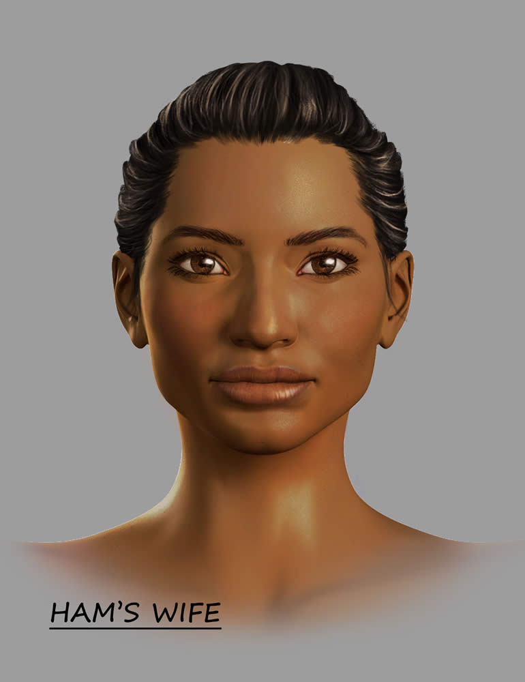
Ark Encounter – Ham’s Wife
https://arkencounter.com/blog/2014/08/27/depicting-the-arks-passengers-hams-wife/
Ham’s wife may have been the darkest of anyone on the Ark. This would fit with the idea that many of their descendants settled in Africa. Since she will be the darkest, she will also have dark hair and eyes.
There’s also the possibility that some of Ham’s descendants spread to East and Southeast Asia, so his wife could display some of the facial features and skin tones that are common to people in this region.

Slide 10
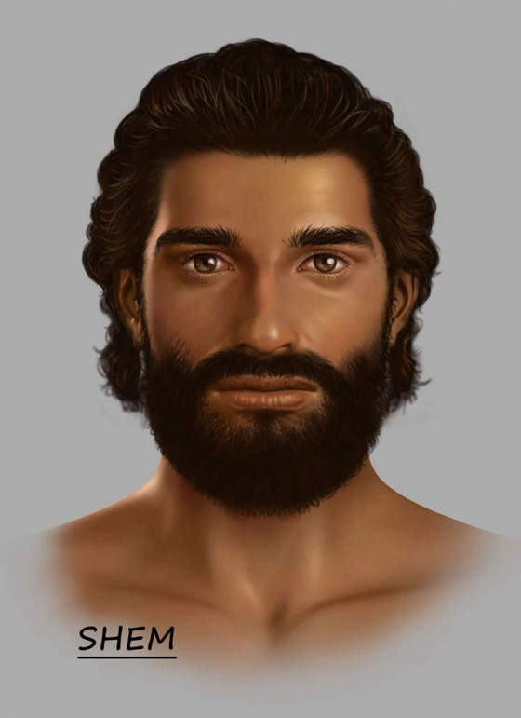
Ark Encounter – Shem
https://arkencounter.com/blog/2014/09/02/depicting-the-arks-passengers-shem/
Shem may well have been the darkest person on the Ark, since many of his traceable descendants range from being dark to lighter middle brown. His skin shade will still be middle brown, and he’ll have brown eyes and dark brown hair.
Many of his descendants settled in the Middle East—the Israelites, Arabs, and Assyrians come from him, and many in India are likely his descendants too. We can make him the shortest of the brothers...

Slide 11
Ark Encounter – Shem
https://arkencounter.com/blog/2014/09/02/depicting-the-arks-passengers-shem/
Since Shem is the great, great . . . grandfather of Abraham, Isaac, and Jacob, and because the Lord is called the “God of Shem” in Genesis 9:26, we may want to depict Shem as being more devoted to God than his brothers are. Since many of his distant descendants were shepherds…we could portray Shem working with the sheep kind at one point.

Slide 12
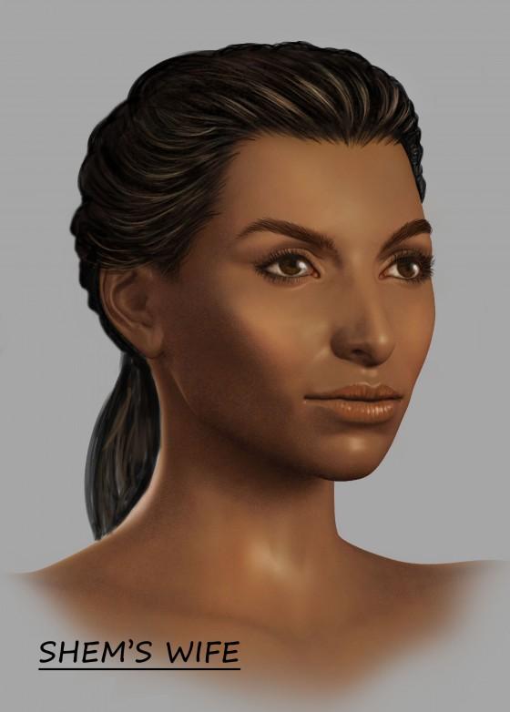
Ark Encounter – Shem’s Wife
https://arkencounter.com/blog/2014/09/03/depicting-the-arks-passengers-shems-wife/
Shem’s wife is in the line of the Messiah and is married to the man we plan to portray as the godliest of Noah’s sons. This probably won’t affect her appearance, but it could help us determine the various activities we show her performing.
As for her appearance, we really don’t have anything to go on. She can be fairly average in size but still physically fit. She will have middle-brown skin, brown hair, and brown eyes.

Slide 13


Ark Encounter Women
Ark Encounter blog posts infer that most diversity of physical traits (eye, hair and skin color) came from the wives of Japheth, Ham and Shem.

Slide 14
Ark Encounter Men
Ark Encounter blogs infer that these three sons of Noah (full brothers) have traits that were passed down to descendants, including both spiritual and personality qualities.

Slide 15






Ark Encounter’s Childish View of Genetics
7 Billion people of wide diversity from 6 people (3 full brothers and their wives) only 4000 years ago, or 200 generations.
Wives were more responsible for physical diversity than the husbands.
Physical traits of people today were derived from 6 ancestors 200 generations ago.
Psychological traits (quest for power, spirituality, etc.) derived from ancestors 200 generations ago.
Both Africans and Asians descended from Ham and Kezia.
Each couple’s kids mated only with their brothers & sisters and not their cousins.

Slide 16
Ark Encounter Claims Refuted By Science
Genetic diversity is greatest in Africa. Humans lived in Africa a long time before migrating out of Africa.
Humans originated in Sub-Saharan Africa, not the Middle East.
Hair, skin, eye color, & geography cannot predict genetic affinity.
Traits can be constant over 200 generations, or traits can derive from mutations from any of the 0 to 200 generations.
Europeans and Asians share more genes with each other than they do with Africans.

Slide 17
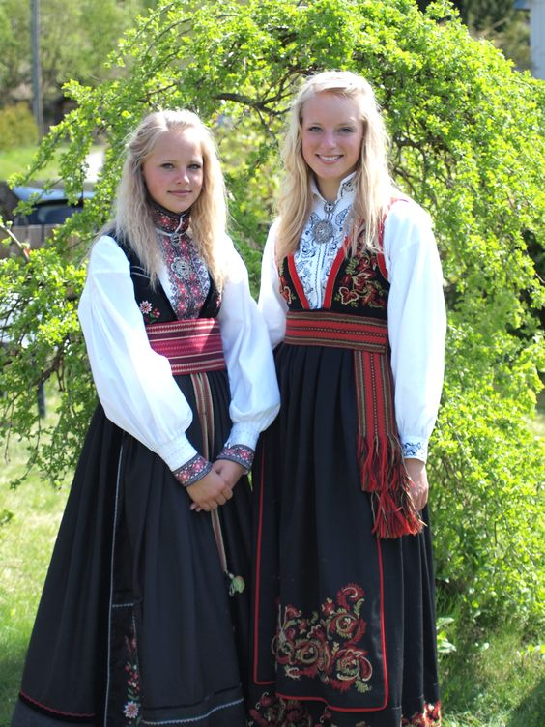
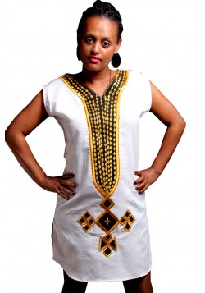
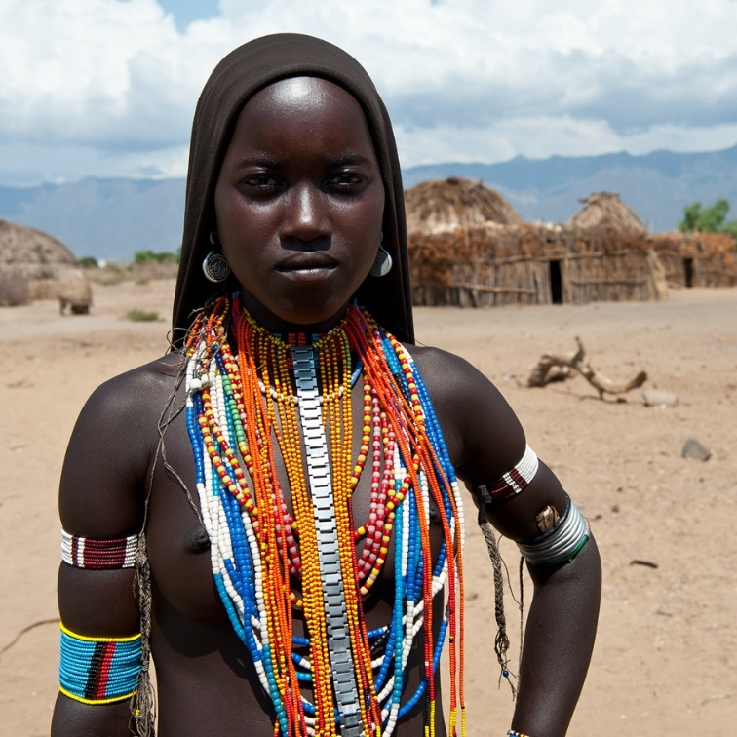
Skin, Hair, Size & Geography
Cannot Infer Relatedness
Ethiopians (center) have closer genetic affinity with Armenians and Norwegians (left) than with Bantu populations (right).^{[42]}
Nature Genetics 29 (3): 265–9.

Slide 18
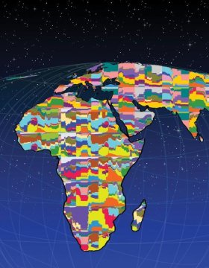
More Genetic Diversity in Africa
Than in Rest of World Combined
A schematic of worldwide human genetic variation, with colors representing different genetic types. The figure illustrates the great amount of genetic variation in Africa.
Illustration by Martin Soave/University of Michigan. ScienceDaily, Feb 21, 2008.
Homo Sapiens lived in Africa a long time before migrating out of Africa. Y-Chromosome (paternal lineage) and Mitochondrial DNA (maternal lineage) show that our most recent common relative is from sub-Sahara Africa, not the Middle East.

Slide 19
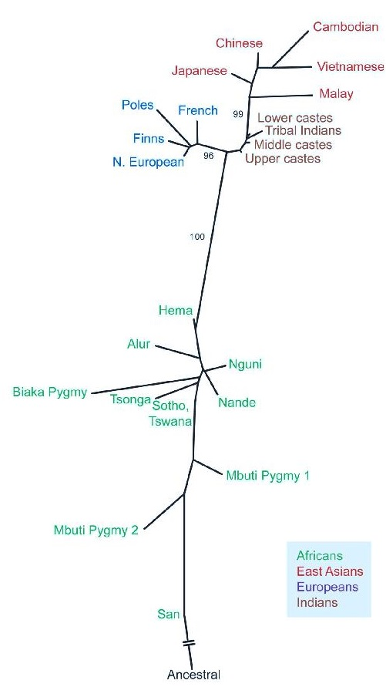
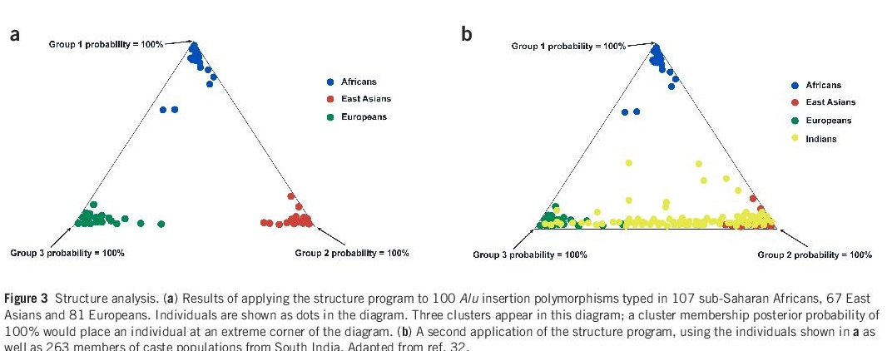
Ham & Kezia – Ancestors of Africans & Asians?
Genetic analysis from multiple studies shows that Asians and Europeans are more related to each other than they are to Africans. This contradicts the claim by Ark Encounter that Ham and Kezia are the ancestors of both Africans and Asians. Images courtesy Nature Genetics Supplement, Vol. 36, Nov. 2004.

Slide 20
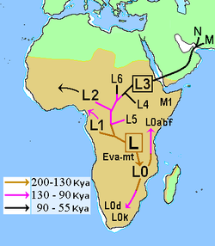
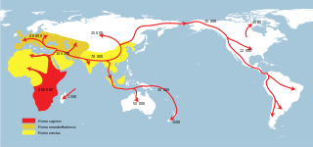
Modern Genetics on Mitochondrial DNA
Show Origin in Sub-Sahara Africa, Not Middle East
Map of early diversification of modern humans according to mitochondrial population genetics (see: Haplogroup L).
https://en.wikipedia.org/wiki/Recent_African_origin_of_modern_humans
https://en.wikipedia.org/wiki/Macro-haplogroup_L_(mtDNA)

Slide 21
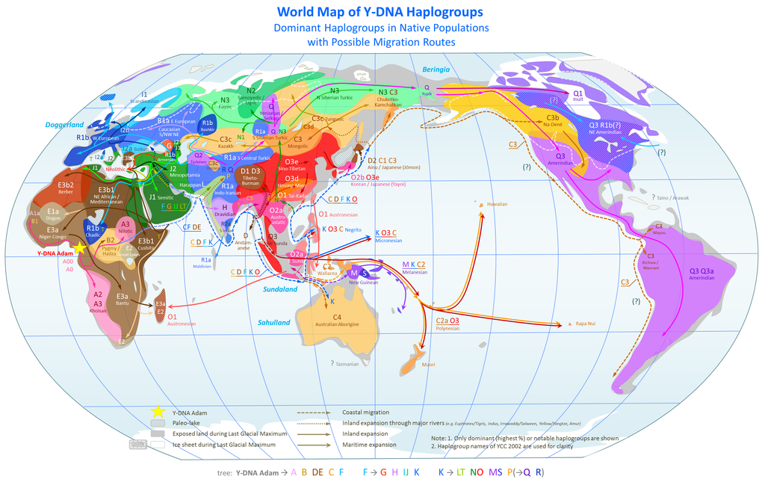
Modern Genetics on Y-Chromosome Show Origin from Sub-Sahara Africa, Not Middle East
Dominant Y-chromosome haplogroups in pre-colonial world populations, with possible migrations routes according to the Coastal Migration Model.
https://en.wikipedia.org/wiki/Human_genetic_variation

Slide 22
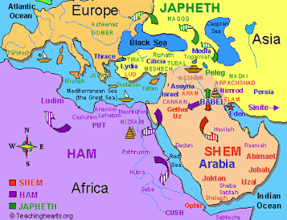
Modern Creationists Show Humans Dispersing from the Tower of Babel in the Middle East

Slide 23
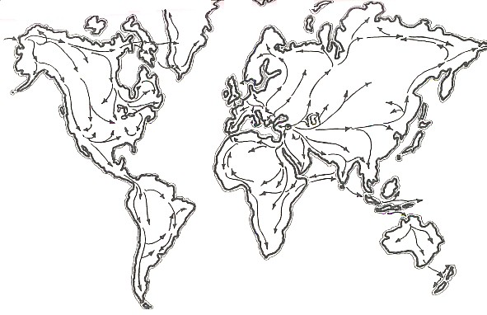
Modern Creationists Show Humans Dispersing from the Tower of Babel in the Middle East
Fig. 1. The probable routes of migration as the world was first peopled.
http://www.custance.org/Library/Volume1/Part_II/Chapter1.html

Slide 24
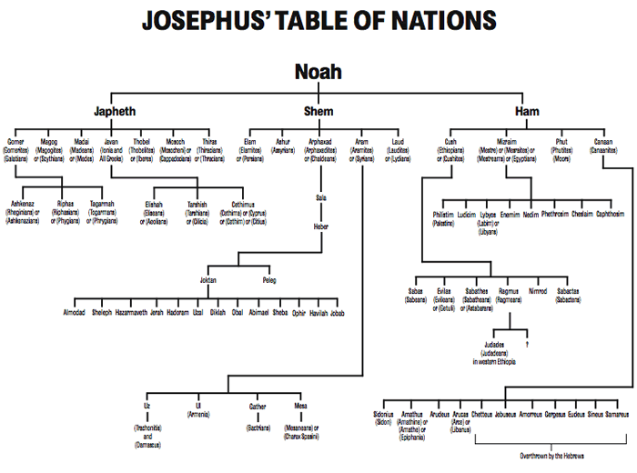
Table of Nations – AiG admires the table from Josephus around 100 CE based on Genesis 10
http://www.answersingenesis.org/articles/aid/v4/n1/josephus-and-genesis-chapter-ten

Slide 25
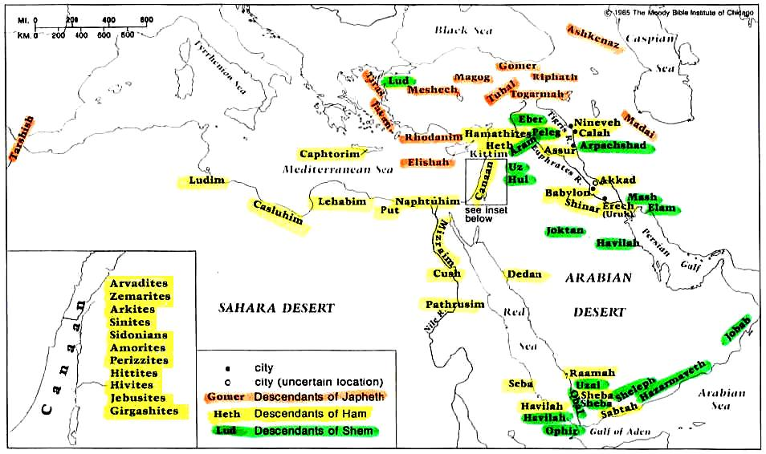
Table of Nations from biblehistory.com

Slide 26
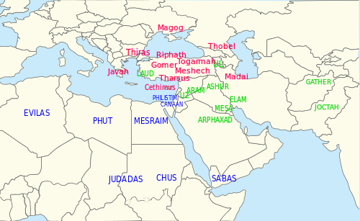
Who is Missing From Table of Nations ~ 100 CE?
Northern Europeans
East Asians
Australian Aborigines
Natives of North and South America
Many others
Geographic Identifications of Flavius Josephus based on the Genesis 10 Table of Nations around the start of Christianity in 100 CE.

Slide 27
Christian Rome Adds to Table of Nations
Northern peoples important to the Late Roman and medieval world, such as the Celts, Slavs, Germans and Norse were not covered, nor were others of the world's peoples. A variety of fanciful arrangements were devised by scholars, with for example the Scythians, who do feature in the [Jewish] tradition, being claimed as the ancestors of much of northern Europe.^{[5]}
Johnson, James William, "The Scythian: His Rise and Fall", Journal of the History of Ideas, Vol. 20, No. 2 (Apr., 1959), pp. 250-257, University of Pennsylvania Press, JSTOR
Modern Christians Add More to Table of Nations
Because of similar sounds, Mechech is said to be Moscow and Tubal is Tobolsk according to The Scofield Reference Bible, Harry Rimmer, and Hal Lindsey.
Josephus and mainstream scholars associate Mechech with Cappadocians and its capital Mazacah. Tubal is associated with Thobelites, later called Iberes.

Slide 28
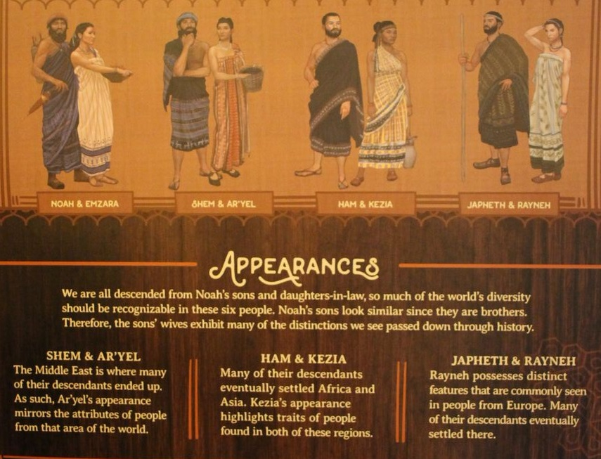
Ark Encounter Passengers
Ark Encounter gave each wife a name and back story, although all were unnamed in the Bible and had no background information.
Photo by Andy Dyson

Slide 29

Japheth & Rayneh – Ancestors of Europeans
Rayneh does have the lightest skin of all ark passengers.
Photo by Andy Dyson

Slide 30
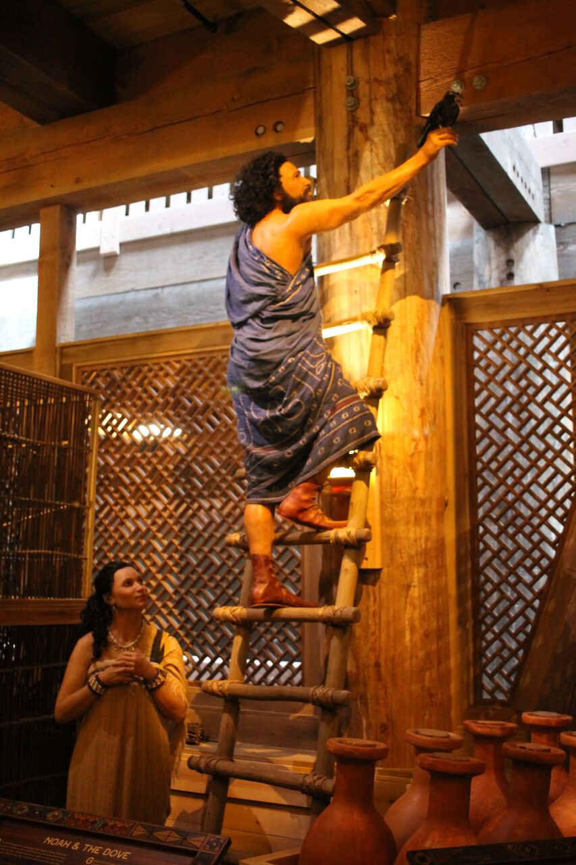
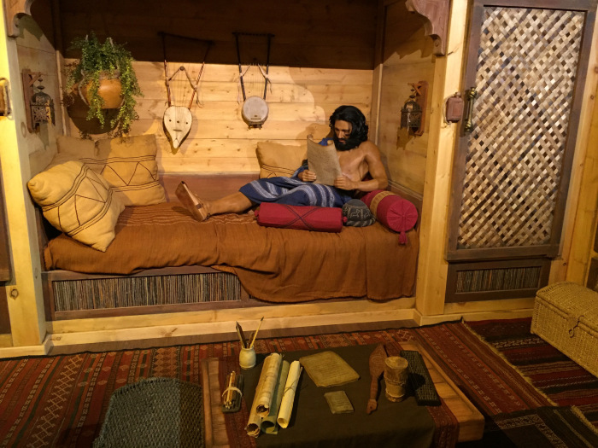
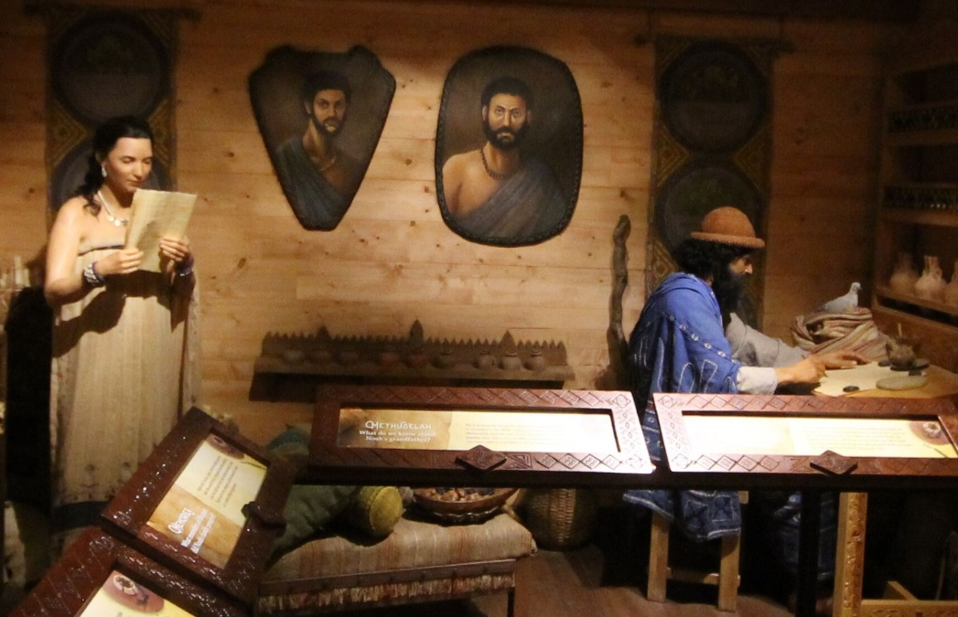
Shem and Ar’yel– Ancestors of Middle Easterners
Shem looks like a Middle Eastern version of Jesus from famous art.
Photo by Andy Dyson

Slide 31

Ham & Kezia – Ancestors of Africans & Asians
Kezia does have the darkest skin of all ark passengers.
Photo by Andy Dyson

Slide 32




KY Freethought Convention, Sep 2, 2017
Muhammad Ali Center, Louisville

